Slide 1
Using Statistical Methods to Better Understand E-Resources Usage Data
Yongming Wang and Jia Mi
VALE Annual Conference 2019
Busch Campus, Rutgers University
January 4, 2019

Slide 2
Outline
Project Goals and Background
Project One: Correlation Analysis
Project Two: Linear Regression
Conclusion

Slide 3
About TCNJ and Library E-Resource
TCNJ
4-year undergraduate institution
FTE 7,000
Library E-Resources
100+ Databases*
Unique Journals Titles 93,236
*700 individually subscribed E-journals

Slide 4
Project Background
How to Make Better Understanding of ER Usage Data
Current ER Usage Data Sources
Publisher Supplied Usage Data (Counter Compliant Data)
Publisher Supplied Usage Data (non-Counter Compliant Data)
EZProxy Data
Google Analytics
360 Link
EBSCO EJS
Previously Used Data Analysis Tools
Excel
Tableau
LibInsight

Slide 5
Project Goal and Objective
Goal
Applying statistical methods to model ER usage data, to quantify the trend and to find the relationship between different variables
Objective
Using two commonly used statistical methods for our data analysis:
Project 1: Using Pearson Correlation technique to analyze the relationship between online journal’s full-text download and the journal’s impact factor
Project 2: Using Linear Regression method to model database’s monthly search and full-text download data; to find the trend and to predict the future usage
Hope our findings can help in evidence-based library collection decision making process
Statistical Software
SAS, SPSS, MatLab, and R, etc.
Choose R/RStudio
Easy to use
Powerful
Rich set of packages
Open source

Slide 6
Project One: Using Pearson Correlation Coefficient to Analyze Library Individually Subscribed E-Journals
Question: with 700 individually subscribed e-journals, is there a relationship between journal’s impact factor and its full-text download? If yes, what is the relationship?
Brief Introduction to Pearson Correlation Coefficient (r)
Definition: to measure the linear correlation between two continuous variables. A continuous variable is a variable that can be measured along a line scale.
r value interpretation (range: -1 to +1)
-0.99 to -0.6 strong negative relationship
-0.59 to -0.3 moderate negative relationship
-0.29 to 0.29 weak correlation
0.3 to 0.59 moderate positive relationship
0.6 to 0.99 strong positive relationship
Special cases: 0: no relationship; -1: perfect negative; +1: perfect positive
Note: Only for r > 0.3 or < -0.3, the statisticians will be interested in further investigation
Warning: Correlation does not imply causation!!!

Slide 7
Sample Scatterplots with Associated Pearson Correlation Coefficients
Source: https://en.wikipedia.org/wiki/Pearson_correlation_coefficient

Slide 8
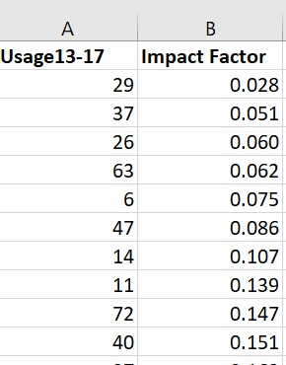
Data
Five year full-text download: 2013 - 2017
Journal Impact Factor: searching titles from Journal Citation Report, out of 667 journals found 338 with impact factor, using most recent year available impact factor
Data:

Slide 9
Scatterplot

Slide 10
R Code
Pearson Correlation Coefficient Analysis of Journal Impact Factor vs. FT Download:
# importing data
> library(readxl)
> impact <- read_excel("~/TCNJ/conference/VALE/VALE2019/data/journal/VALE-Journal.xlsx")
> View(impact)
# drawing scatterplot
> pairs(impact)
> plot(impact$`Impact Factor`, impact$`Usage13-17`)
# conducting Pearson Correlation Coefficient method
> res <- cor.test(impact$`Impact Factor`, impact$`Usage13-17`, method = "pearson")
> res (see next slide for result)

Slide 11
Result and Interpretation
Result:
Pearson's product-moment correlation (r)
data: impact$`Impact Factor` and impact$`FT Download`
t = 3.7265 (greater than the critical t value of 3.291, null hypothesis is rejected), df = 336, p-value = 0.0002277 (it indicates how likely it is that a result occurred by change alone)
alternative hypothesis: true correlation is not equal to 0
95 percent confidence interval: 0.09455362 ~ 0.29953207
sample estimates:
cor: 0.199221 (r = 0.20) (weak positive relationship)
(r is statistically significant at p < 0.001)
Interpretation(Report): There is a weak positive relationship between the journal’s downloads and its impact factor. This result is statistically significant. In other words, there is a less than 5% of probability that the finding could have been due to chance.
Limitation: The data includes different disciplines and each discipline has different magnitude and implication of impact factor. That could be the reason why r is so small.
Next we calculate Pearson’s r for 60 journals in health science (LC Class “R”)

Slide 12
Scatterplot of 60 Journals in Health Science
Outlier

Slide 13
Results of 60 Journals in Health Science
Pearson's product-moment correlation coefficient
(R Code skipped)
data: impact_Medicine$`Impact Factor` and impact_Medicine$`Usage13-17`
t = 3.9734 (greater than the critical t value, null hypothesis is rejected), df = 58, p-value = 0.0001984
alternative hypothesis: true correlation is not equal to 0
95 percent confidence interval: 0.2364017 ~ 0.6411750
sample estimates:
cor: 0.4625598 (r=0.46) (Moderately Positive Correlation)
(r is statistically significant at p < 0.001)
(After removing the outlier, r=0.50)
Interpretation(Report): There is a moderately positive relationship between the medicine journals’ downloads and its impact factor. This result is statistically significant. In other words, there is a less than 5% of probability that the finding could have been due to chance.
Warning again: Correlation does not imply causation!!!

Slide 14
Project Two: Applying (Simple) Linear Regression to monthly data of database search and full-text download
Brief Introduction to (Simple) Linear Regression
Data
Scatterplot
Results and Interpretations
Sample R Code

Slide 15
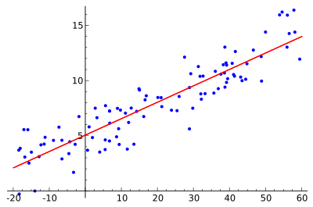
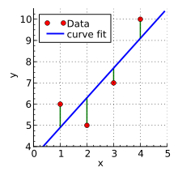
Brief Introduction to (Simple) Linear Regression
Linear regression is a statistical method to model the linear relationship between one response (also called dependent) variable and one or more explanatory (also called independent) variables. If there is only one explanatory variable, it’s called simple linear regression. If more than one explanatory variables, multiple linear regression.
For example, we could use simple linear regression to model the student’s GPA (response variable) and his or her use of library (explanatory variable). If we add another explanatory variable such as the class attendance, then it would be multiple linear regression.
Linear regression is closely related to correlation analysis (r > 0.3 or r < -0.3)
It is about fitting a straight line to the scatterplot (left picture)
How the fitting line is calculated: the least squares method (right picture)
Source: https://en.wikipedia.org/wiki/Linear_regression
Source: https://en.wikipedia.org/wiki/Linear_least_squares

Slide 16
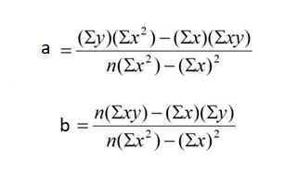
Formula of Simple Linear Regression
The straight fitting line: Y = a + bX
X: explanatory variable
Y: response variable
a: intercept (when x = 0, y is the intercept)
b: slope, also called the angle (degree of relationship, different from strength of relationship determined by r)
to calculate “a” and “b”, use the following formula:

Slide 17
Data
We choose five databases (one general, one from business, one from Humanities, two from psychology);
Academic Search Premier, both search and FT
Mergent, both search and FT
Jstor, both search and FT
PsycInfo, search
PsycArticle, FT
We use their monthly search and full text (FT) download data, from Jan. 2006 to Nov. 2018 (155 months). So we have a total of 155 pairs of search and FT data for each database, except PsycInfo and PsycArticle.
The monthly data are also time series data in statistics. There are many time series data. The daily historical stock data are another time series.
Limitation of using simple linear regression for time series data analysis
Basic and Preliminary
Time series data is related to each other but linear regression considers each pair of data are independent
There are better models for time series analysis such as ARIMA (Autoregressive Integrated Moving Average)

Slide 18
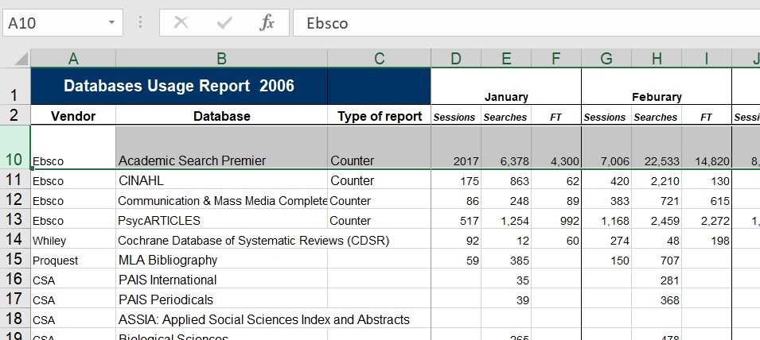
Raw Data
Academic Search Premier (ASP) Monthly Search and Full Text download from 2006

Slide 19
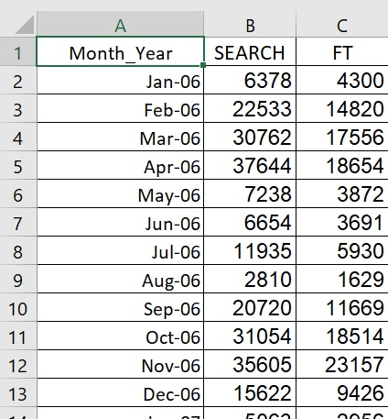
Sample Prepared Data
Intermediate (manually) Final

Slide 20
ASP – Search – FT – Scatterplot with Fitting Line

Slide 21
Mergent Search and Page View (PV) Scatterplot with Fitting Line
outliers

Slide 22
JSTOR Search and FT Scatterplot with Fitting Line

Slide 23
PsycInfo (Search) and PsycArticle (FT) Scatterplot with Fitting Line

Slide 24
ASP – Search - Linear Regression – Result
Call:
lm(formula = vale_asp_search ~ time(search))
Residuals:
Min 1Q Median 3Q Max
-17364.9 -9589.9 -633.7 7982.4 29618.5
Coefficients:
Estimate Std. Error t value Pr(>|t|)
(Intercept) 1619534.1 460703.3 3.515 0.000578 ***
time(search) -797.1 228.9 -3.482 0.000650 ***
---
Signif. codes: 0 ‘***’ 0.001 ‘**’ 0.01 ‘*’ 0.05 ‘.’ 0.1 ‘ ’ 1
Residual standard error: 10630 on 153 degrees of freedom
Multiple R-squared: 0.07341, Adjusted R-squared: 0.06736
F-statistic: 12.12 on 1 and 153 DF, p-value: 0.0006497

Slide 25
ASP – Search – Linear Regression – Result Interpretation
Because: Y = a + bX, and in our project, Y is Search, X is Year
Thus: “Search = 1619534 – (797 x Year)”
Interpretation (Report):
The linear regression analysis indicated that the time factor (month/year) was significantly related to the database search data. As the time increases by one year, the search decreases by 797.
adjusted R² = 0.07, F(1, 153) = 12.12, p < .001

Slide 26
Summary of Results (Search)
Database | Intercept | Slope | p | R²
ASP | 1,619,534 | -797 | 0.00065 | 0.07
Mergent | -152,390 | 76 | 0.0066 | 0.04
JStor | 499,944 | -245 | 0.0034 | 0.05
PsycInfo | 271,065 | -129 | 0.4146 | -0.002
Note 1: If the p value is greater than 0.05, the result is discarded.
Note 2: If the R² is negative, the regression should be dumped.
Use the mean instead.

Slide 27
Summary of Results (FT)
Database | Intercept | Slope | p | R²
ASP | 1,110,295 | -547 | 0.000034 | 0.13
Mergent | -558,409 | 279 | 0.0017 | 0.06
JStor | -70,621 | 38 | 0.7197 | 0.01
PsycArticle | -35,304 | 18 | 0.5123 | -0.004

Slide 28
ASP – Search - Linear Regression – R Code
# import data
> library(readxl)
> VALE_ASP_SEARCH <- read_excel("~/TCNJ/conference/VALE/VALE2019/data/ASP/VALE-ASP-SEARCH.xlsx",col_types = c("numeric"))
> VALE_ASP_FT <- read_excel("~/TCNJ/conference/VALE/VALE2019/data/ASP/VALE-ASP-FT.xlsx",col_types = c("numeric"))
# make time series object
> vale_asp_search <- ts(data = VALE_ASP_SEARCH, frequency = 12, start = c(2006,1))
> vale_asp_ft <- ts(data = VALE_ASP_FT, frequency = 12, start = c(2006,1))
> library(astsa)
# draw scatterplot, do linear regression, fit line
> par(mfrow = c(2,1))
> tsplot(vale_asp_search, type = "o", xlab = "Year/Month", main = "ASP Search 13 Years")
> fit <- lm(vale_asp_search~time(vale_asp_search))
> abline(fit)
> summary(fit)

Slide 29
RStudio Interface

Slide 30
Conclusion
Benefits
Discover some relationships among variables such as journal impact factor and full-text download
Reveal the trend and predict the future by modeling the data
Challenges
Data accuracy
Collect meaningful and complete data
Choose the most appropriate statistical methods for data analysis
Limitation
For Pearson correlation, it would be nice if we have more data on other disciplines
Linear regression is not the best method for time series analysis; It’s used for preliminary study only. Other models such as ARIMA are more appropriate
Future Plan
Collect and use library user data and demographic data to combine with resources usage data for correlation analysis
Use ARIMA model for time series data for better trend analysis and forecasting
Use multiple linear regression to reveal complex relationships among variables and to model the trends more accurately
Notes:
Limitation: means the missing piece from this project. Data cleanup for a bigger project
***It needs time, and maybe, permission from school authority

Slide 31
Thank You
Questions?
Yongming Wang, Systems Librarian: wangyo@tcnj.edu
Jia Mi, Electronic Resources and Serials Librarian: jmi@tcnj.edu

