Slide 1
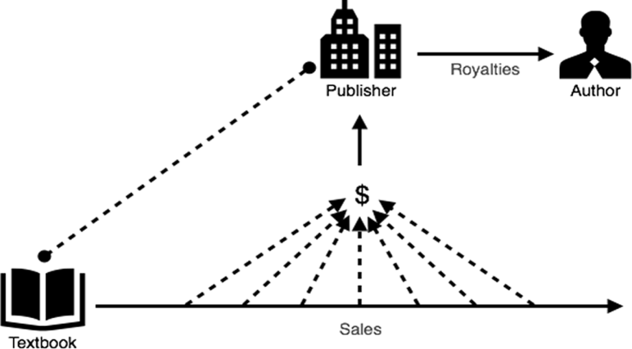
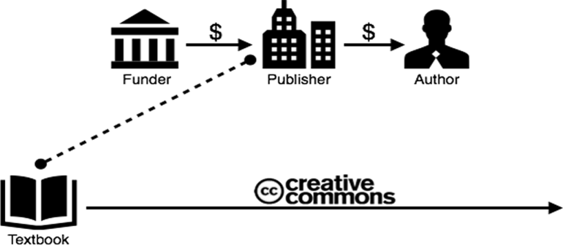
Show Me the Money! How OER Publishing Works
Megan Dempsey, Evelyn S. Field Library
Publishing images by Sarah Cohen (2016)
Commercial Publishing Model
Open Publishing Model
Open publishing eliminates the cost of updating and distributing content.
Who is funding OER?
With Oregon State Legislature, funding Open Oregon Educational Resources
$4.9 million awarded by Congress to UC Davis’ LibreTexts
$8 million in grants to Rice University, MIT, Carnegie Mellon & others
$16 million to SUNY & CUNY for open textbook development
Free, open eBooks for legal education

