Slide 1
Student Learning of Information Literacy Skills Under Three Pedagogies
Moore Library
Ma Lei Hsieh Patricia Dawson Melissa Hofmann
English Dept.
Megan Titus
Psychology Dept.
Michel Carlin
Rider University
January 4, 2013 , Piscataway, NJ
2013 VALE Conference

Slide 2
Overview
How did Rider U. Library engage faculty in instruction and assessment of student learning in information literacy (IL)?
IL learning objectives
Methodology for teaching and assessment
Experimental groups in Spring 2012
Findings
What did we learn?
Next steps

Slide 3
Learning Objectives of Information Literacy for Undergraduates at Rider University
Students will identify a variety of types and formats of potential sources of information.
Students will develop keyword strategies and access relevant information effectively from the most appropriate resources.
Students will evaluate resources critically
Students will use information ethically and will cite their sources appropriately. (Based on the Information Literacy Competency Standards for Higher Education from ACRL)

Slide 4
Engaging faculty in assessment & teaching
1. Develop test questions
10. Determine
next cycle of assessment
2. Pilot/revise questions
3. Install tests in Google Docs
9. Modify strategies in teaching
Information Literacy Objectives
8. Share findings among librarians & faculty
4. Pretest
7. Tabulate and analyze data
5. Research Instruction
6. Posttest in follow-up sessions prior to instruction

Slide 5
Assessment Instruments
Un-identical Pretest and Posttest for - IL Objective 1: Understanding Sources (5 items)
- IL Objective 2: Structuring Queries Properly (5 items)
Two correct answers for each question
Corresponding questions in parallel structure
Conservative rule in scoring

Slide 6
Assessment Instruments continued
Demographic items in the tests
Course (CMP-125, BHP-150)
Class (FR, SO, JR, SR)
Area of Study
Scaffolding activity with worksheet
One-minute paper
Quiz (teaching faculty designed)
Teaching faculty observation
Student reflection of learning

Slide 7
Help for students in learning IL
Research guides for classes
Additional research guide pages on the use of different types of sources and when best to use which type
Online tutorials on basic IL concepts.
Answers/rationale sheet to students after the first research instruction (RI) session for them to review and learn about the IL concepts

Slide 8
Target Audience of Assessment
Research Writing (CMP-125).
Baccalaureate Honors Program (BHP-150).
1st Year | 2nd Year | 3rd Year | 4th Year & other
82% | 13% | 4% | 1%

Slide 9
Experimental Groups for Instruction & Assessment
Preview: students previewed research guide and took graded quiz before or right after the RI session.
Active Learning: students did a scaffolding worksheet to define topic and keywords, and use of AND/OR/Truncation/Phrase Search.
Multiple-sessions: two librarians taught 2 RI sessions and helped multiple follow-ups with three classes. One class did not take the pretest (group B).

Slide 10
Other Groups for Instruction and Assessment
4. BHP – took only the pretest.
Pretest only – did not attend a follow-up session.
Control group – took pre- and posttests but did not receive extra reinforcement.

Slide 11
Sample Sizes (N)
Group | Pretest | Posttest | Pre-post Matching
Preview | 52 | 46 | 39
Active Learn | 40 | 42 | 36
Multi-session | 35 (A) 0 (B) | 34 (A) 16 (B) | 26 (A) 0 (B)
Pretest only | 116 | 0 | 0
BHP | 66 | 0 | 0
Control | 17 | 15 | 10
Total | 326 | 153 | 111

Slide 12
Preview Group – Teaching Method Instructor 1
First Session:
Assigned Research Guide prior to the first session on (pretest)
Quiz after first session
Research Proposal due after first session
Second Session:
Assigned Research Guide prior to the second session (different topic) (posttest)
Proposal and Annotated Bibliography due after second session

Slide 13
First Session: Quiz Questions
If you are looking for articles on women in femininity, why might you use the term “femini*” as your search term?
On the Rider Library homepage, what will each of the following links help you find?
Online Catalog
Databases and Indexes
Journal Holdings
What is a working bibliography, and why is it
important to use when writing a research essay?
4. If my topic is “definition of ‘man,’” what might be
an example of a research question I could use to
explore my topic further?

Slide 14
Results of the Quiz (17 students)
15 got Question 1 correct (88%)
12 got Question 2a correct (70%)
12 got Question 2b correct (70%)
5 got Question 2c correct (29%)
(8 got ½ credit; 4 got no credit)
15 got Question 3 correct (88%)
15 got Question 4 correct (88%)

Slide 15
Second Session: Goals of the Assignment
Annotated Bibliography: help students prepare for the Exploratory Essay by finding and evaluating sources
Exploratory Essay (Essay 3 of 4)
Help students begin to make more in-depth connections between their research and their own ideas
Examine topic from a variety of perspectives
Arrive at a thesis
Points awarded for critical analysis of research and discussion of how research informs thinking on a topic

Slide 16
Essay 3 Results
Average grade: 89.7%
Average grade of:
Essay 1: 87.2%
Essay 2: 88%
Essay 4: 89.4%

Slide 17
Students’ Thoughts on the Exploratory Essay
“My writing technique definitely changed significantly after Essay 3, the hypothesis-driven essay.”
“As a result of this different style paper, I am now a better researcher because I learned to break down and analyze my sources as well as their credibility and importance.”
“I now understand that researching the sources is just as important as researching the topic. Using data that is inaccurate, skewed, or distorted to a particular perspective for biased reasons can lead to inappropriate conclusions. The annotated bibliography exercise in particular helped me to realize that a thorough analysis of the source actually leads to ideas that can be incorporated into the essay as substantiation of the thesis.”

Slide 18
Preview Group – Teaching Method Instructor 2
First Session:
Assigned Research Guide three weeks prior to the first session (pretest)
Reviewed in class; in class exercises assigned
Quiz given week before first session
Topic proposal and working bibliography due three days after first session
Second Session:
Posttest and hands-on (a month later)
Final paper due one week later
Notes:
Extensive, instructor-delivered exposure to the Research Guide.
In-class exercises included:
Finding a book
Finding a scholarly article
Evaluating a website and giving an oral report (in pairs)
Each assignment was worth 1% of grade
Online quiz on Blackboard was open for a week before the Research Instruction session. (40 min.) 10 questions from a pool of 20. Randomized questions and randomized order for answers.
I collaborated with Judy on her quiz. I crafted questions taking concepts and language directly from the Research Guide, as she wanted the quiz to be relatively easy. Since the goal of the quiz was to make sure the students reviewed the guide, I thought such a strategy was best, especially because it was an online quiz with a time limit of 40 minutes, I assumed it likely that the student would have the guide open in another browser tab for reference. Perhaps such an open-book approach would be desirable, as students would be looking for specific answers and would be rewarded for having previewed the material beforehand. She customized one or two of the questions to be relevant to the students’ topic, Frida Kahlo.
Judy states, “The quiz was designed to emphasize the search strategies taught [in] the Guide, to be easy, and to dispel myths about research.”
Working bibliography of 10 items was to contain at least:
4 scholarly articles
4 books/book chapters
2 of any other source evaluated by the student
The quiz and the working bibliography were each worth 10% of the students’ grade.
Second session: Students were barely engaged; did not ask instructor or librarian for much help

Slide 19
Preview Group – Instructor 2: Results
Quiz: (38 students)
9 earned a perfect score of 10 (24%)
8 earned a score of 9 (21%)
7 earned a score of 8 (18%)
6 earned a score of 7 (16%)
8 did not take the quiz at all (21%)
Working bibliography to first draft:
Students reverted to web sources
Final Papers
Students did not heed instructor feedback to revise
Hard to break student attitudes and research habits

Slide 20
Did Pre-Exposure Help?
Preview groups scored higher on pre- and posttests, but not statistically significant
Student engagement varied between instructors
Familiarity with concepts helped
Professor-class dynamic
Topic choice
Preview/quizzes alone did not translate into a better final product
Reflective and holistic component of assignment is key

Slide 21
Active Learning Group – Teaching Method
Before 1st session:
PreTest
During 1st session:
Overview of Library resources, search strategies,
Worksheet
Before 2nd session:
Posttest
End of 2nd session:
One Minute Paper

Slide 22
Active Learning-Findings from Scored Rubric of Worksheets
Identifying Main Keywords:
Score | Group 1(N = 23) | Group 2 (N = 20)
Exemplary | 65.2% | 60%
Competent | 26.1% | 25%
Needs Work | 8.7% | 15%
Construction of Query:
Score | Group 1(N = 23) | Group 2 (N = 20)
Exemplary | 26.1% | 20%
Competent | 34.8% | 45%
Needs Work | 39.1% | 35%

Slide 23
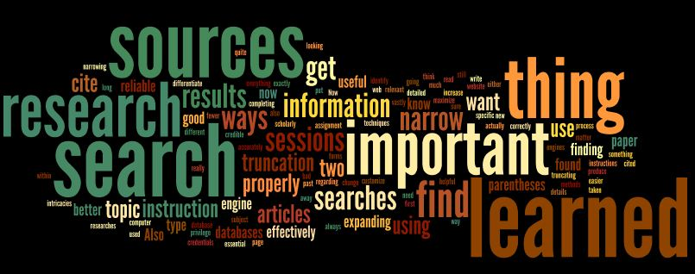
What is the Most Important Thing You Learned? (One Minute Paper)

Slide 24
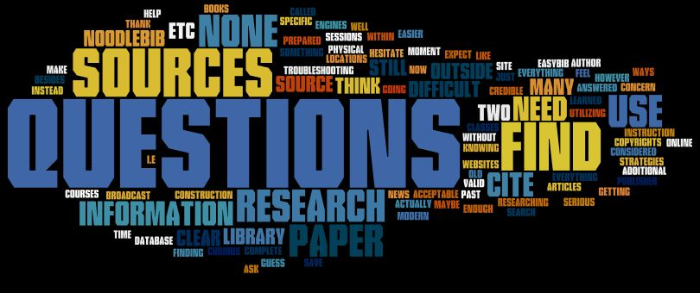
What Questions do You Still Have? (One Minute Paper)

Slide 25
Active Learning Group - Findings
Statistically not different from other groups
Worksheet needed to be revised to be clearer
Librarian’s comments on students’ worksheet:
Many had a hard time following directions (don’t read directions carefully)
Problems with synonyms
Problems with connectors especially “OR”
May understand structured queries (one minute paper comments) but not able to apply (based on worksheet results)
Gave some clues about students’ difficulties with structured searches

Slide 26
Multi-Sessions Group
 | N | Sessions offered | Follow-up sessions | Pretest | Posttest | 2nd posttest
Multi-session A (90-min. & 60-min. classes) | 35 | 2 | 2 (90- minute); 5 (60-minute) | Yes | Yes | Yes
Multi-session B (60-min. class) | 16 | 2 | 5 | No | Yes | Yes

Slide 27
Two Posttests for Multiple-Sessions Group

Slide 28
Overall Findings of Students’ IL Spring 2012
10% in the pretest,
13% in the posttest did not follow the instructions to select 2 correct answers.

Slide 29
Pretests of Students by Groups Spring 2012

Slide 30
Posttests by Groups, Spring 2012

Slide 31
Pre- and Posttest Scores for Questions 1- 5 by Groups (Objective 1 - Identify Sources)

Slide 32
Pre- and Posttest Scores for Questions 6- 10 by Groups (Objective 2 – search skills )

Slide 33
Pre- Posttest by Groups
No significant differences were found between pre- and posttests for all groups
No group differences were detected

Slide 34
Pre- and Posttest by Questions

Slide 35
What did we learn?
Faculty engagement is critical in RI and assessment of student learning.
Much more reinforcement of IL than currently offered is needed to help students.
Students learned the second IL objective (search query) much better
Most students did not fully understand the different types of sources or how to locate the library’s journals
Multiple assessment instruments provide deeper understanding of student IL skills

Slide 36
What did we learn ? - continued
Answer/rationale sheet given after the first RI session did not help. Students need motivation to learn
Many confounding factors to consider: student’s motivation, nature of assignment, faculty’s teaching method, etc.
One or two RI sessions very limited for students to change research habits and improve their IL skills

Slide 37
Next Steps
Share findings of students IL skills with faculty
Continue engaging faculty in reinforcing the IL concepts in the classroom or through assignments
Librarian and faculty collaboration in integrating IL in assignments and grading
Break into mini modules connected with assignments, use disciplined specific modules
Curriculum mapping to integrate IL into curriculum
Engage and motivate students in learning.

Slide 38
Recommendations
Connect research process with the end product(s)
Scaffolding research process with student reflection on learning.
Faculty & librarian collaborate on developing assignments, topics and/or grading
Consider the quality of the sources in grading
Possibly find the relationship between quality of the sources and the end product.

Slide 39
Questions, Ideas, Comments

Slide 40
References
Pretest: https://docs.google.com/spreadsheet/viewform? formkey=dEgyWVc5MGZYODRTSUJOSW9HeWIwWnc6MQ
Posttest: https://docs.google.com/spreadsheet/viewform?formkey=dG1WTzZoR3pPOERyWlBSRVUzT2xFNmc6MA

