Slide 1
Where are Librarians Learning the Skills Necessary to be Competent and Effective Teachers?
VALE Users'/NJLA CUS/NJ ACRL Conference on Friday, January 4, 2013 Rutgers University, Piscataway.
Nancy Becker, Caldwell College Marlene Doty, Berkeley College
Heather Dalal, Rider University Nicholas Jackson, Bergen Community College
Leslie Murtha, Atlantic Cape Community College
Lynee Richel, County College of Morris
Katherine A. Wiggins, New Jersey Institute of Technology

Slide 2
Mbabu, L. G. (2009). LIS Curricula Introducing Information Literacy Courses Alongside Instructional Classes. Journal Of Education For Library & Information Science,50(3), 203-210.
Courses have traditionally offered training on learning theory, instructional design, teaching techniques, program management among other topics.
LIS programs have used BI, IL, and User Ed interchangeably for courses on instruction.

Slide 3
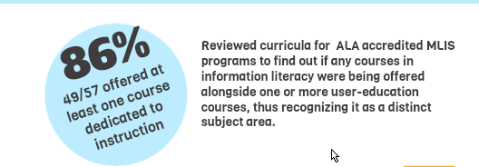
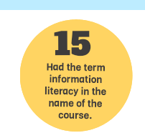
Mbabu, L. G. (2009). LIS Curricula Introducing Information Literacy Courses Alongside Instructional Classes. Journal Of Education For Library & Information Science,50(3), 203-210.

Slide 4
Sproles, C., Johnson, A., & Farison, L. (2008). What the Teachers Are Teaching: How MLIS Programs Are Preparing Academic Librarians for Instructional Roles. Journal Of Education For Library & Information Science, 49(3), 195-209.
72% (39/45)
66% (26/39)

Slide 5
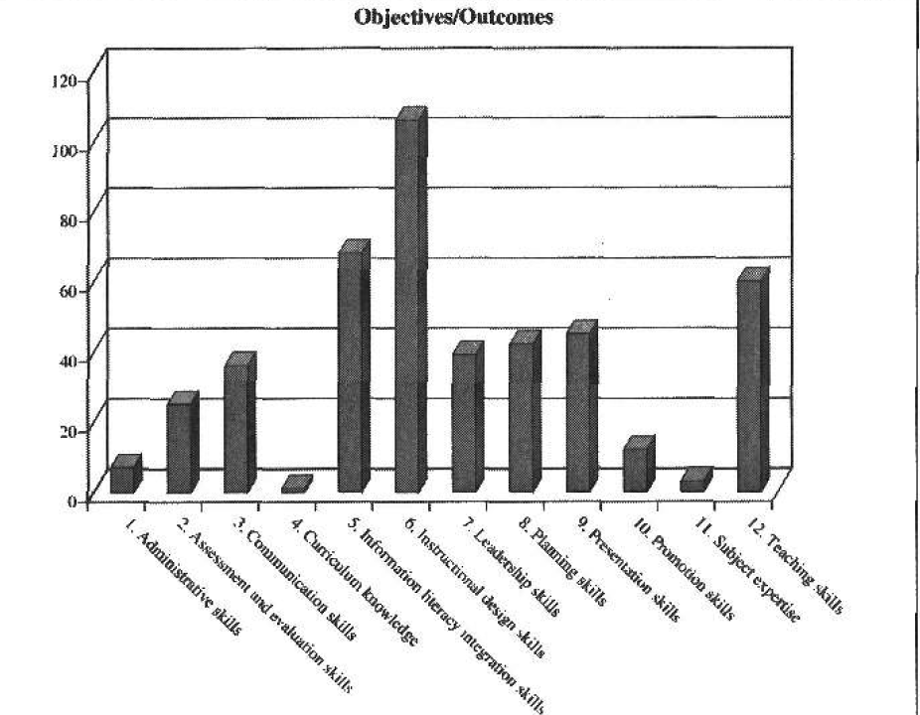
Sproles, C., Johnson, A., & Farison, L. (2008). What the Teachers Are Teaching: How MLIS Programs Are Preparing Academic Librarians for Instructional Roles. Journal Of Education For Library & Information Science, 49(3), 195-209.

Slide 6
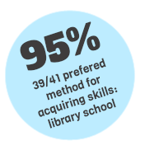
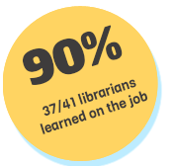
Westbrock, T., & Fabian, S. (2010). Proficiencies for Instruction Librarians: Is There Still a Disconnect Between Professional Education and Professional Responsibilities?.College & Research Libraries, 71(6), 569-590.
For each proficiency, librarians indicated the most significant source from which they acquired it
AND most significant source from which they believe one should acquire it.
Library school is not where librarians are acquiring the proficiencies that they later find very useful

Slide 7
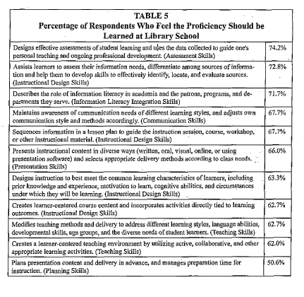
Westbrock, T., & Fabian, S. (2010).

Slide 8
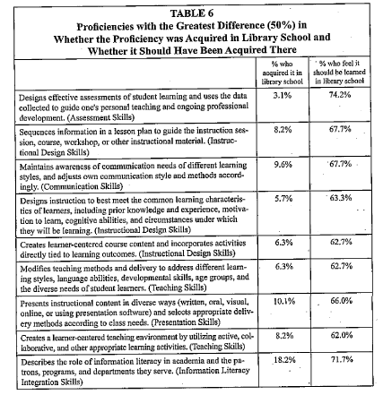
Westbrock, T., & Fabian, S. (2010).

Slide 9
Shank, J.D. & Dewald, N.H. (n.d.) The Evolving Instructional Proficiencies of the Academic Librarian: An Attitudinal Study of Academic Library Administrators’ Perceptions of Necessary Instructional Skills http://lrsv.umd.edu/abstracts/Shank_Dewald.pdf
Asked library administrators to indicate which skills and related proficiencies academic library administrators perceive as most important for fulfilling the instructional role of the library.
Traditional: teaching & Presentation
Two non-traditional:
Educational technologies and instructional design

Slide 10
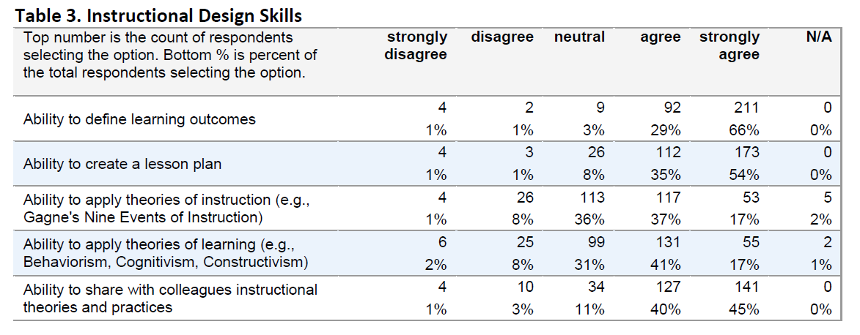
Shank, J.D. & Dewald, N.H. (n.d.) The Evolving Instructional Proficiencies of the Academic Librarian: An Attitudinal Study of Academic Library Administrators’ Perceptions of Necessary Instructional Skills http://lrsv.umd.edu/abstracts/Shank_Dewald.pdf
“When thinking about the necessary or required skills for librarians who participate in the library’s instructional process, please rate the importance on a scale of 1 (strongly disagree) to 5 (strongly agree) for each of the following”

Slide 11
Shank, J.D. & Dewald, N.H. (n.d.) The Evolving Instructional Proficiencies of the Academic Librarian: An Attitudinal Study of Academic Library Administrators’ Perceptions of Necessary Instructional Skills http://lrsv.umd.edu/abstracts/Shank_Dewald.pdf

Slide 12
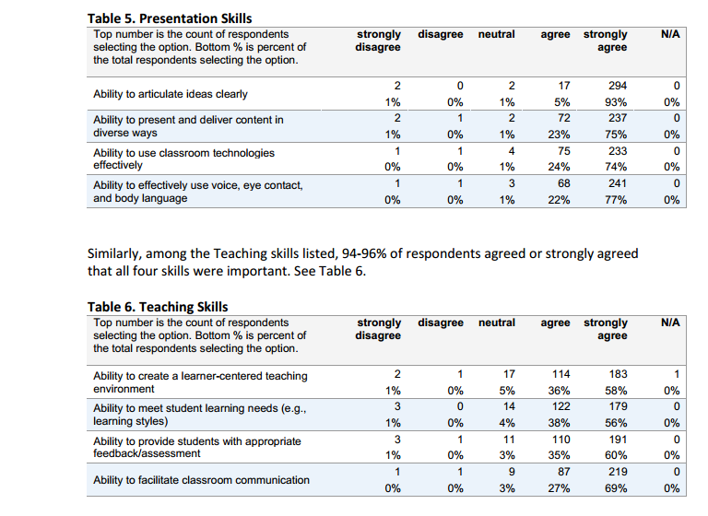
Shank, J.D. & Dewald, N.H. (n.d.) The Evolving Instructional Proficiencies of the Academic Librarian: An Attitudinal Study of Academic Library Administrators’ Perceptions of Necessary Instructional Skills http://lrsv.umd.edu/abstracts/Shank_Dewald.pdf

Slide 13
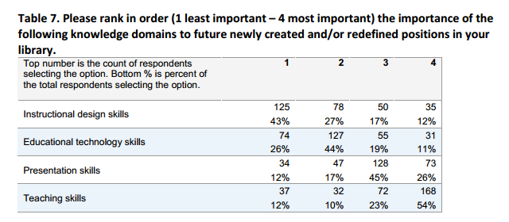
Shank, J.D. & Dewald, N.H. (n.d.) The Evolving Instructional Proficiencies of the Academic Librarian: An Attitudinal Study of Academic Library Administrators’ Perceptions of Necessary Instructional Skills http://lrsv.umd.edu/abstracts/Shank_Dewald.pdf

Slide 14
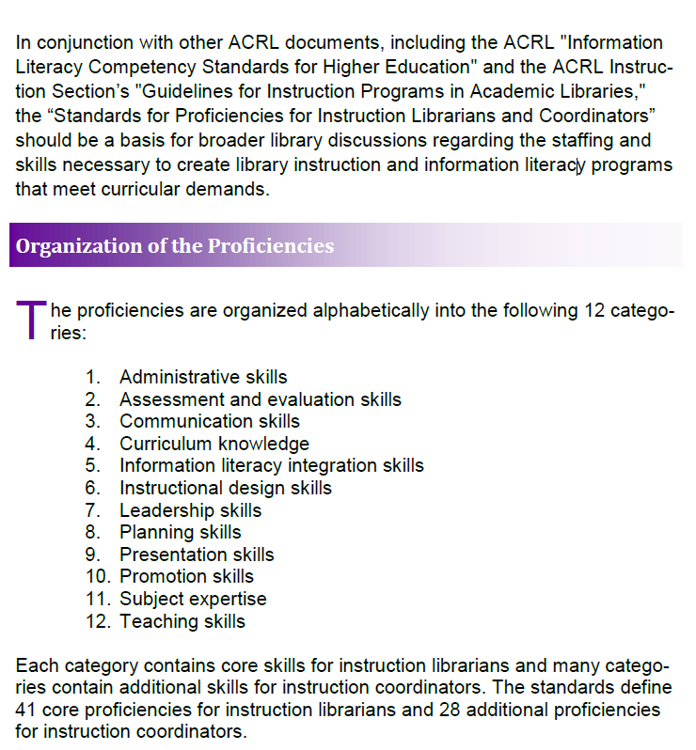
Source:
Association of College and Research Libraries Standards for Proficiencies for Instruction Librarians and Coordinators (2007) http://www.ala.org/acrl/sites/ala.org.acrl/files/content/standards/profstandards.pdf

